Slide 1

ESSENTIAL OILS
CHEM SEC 204TH
Department of Chemistry
Government College
Paonta Sahib (HP)

Slide 2
Topics
JASMINE
CIVETONE
MUSCONE
Chemical constituents
Sources
Uses

Slide 3
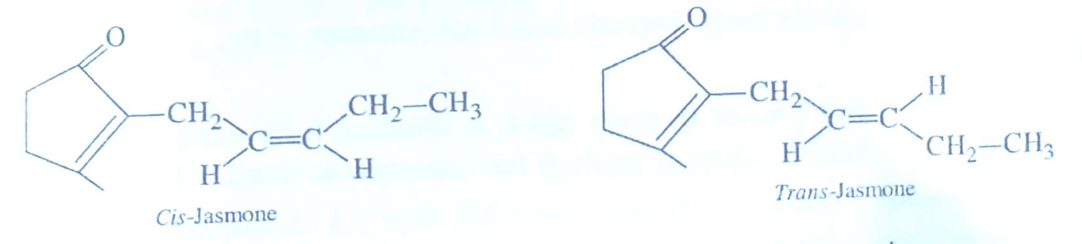
JASMINE
It is an organic compound, which is a volatile component of Jasmine flower oil. It is colourless to pale yellow liquid. This compound exists in two isomeric forms i.e. cis-form and trans-form. In natural compound, cis-form is present only whereas in synthetic Jasmine, both cis- and trans-forms co-exist.
Chemical Composition: The compound exists as two geometrical isomers as shown below have similar odour and chemical properties

Slide 4
Sources:
Jasmine is produced by some plants by metabolism of jasmonic acid, via- decarboxylation. However, it is usually extracted for oils of Jasmine flower.
USES
Jasmone is primarily used in perfumes and cosmetics.
Cis-Jasmone is used in the creation of high quality florals like jasmine and tube rose.
It is used in reconstitution of synthetic essential oils.
Because of its odour, it can he used as insect repellant for different insect species.

Slide 5
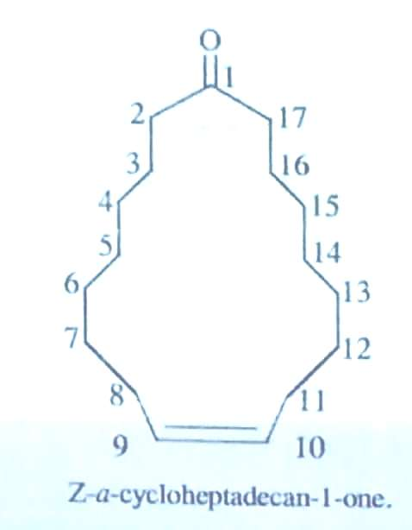
CIVETONE
It is a macrocyclic organic compound which has a keto group on it. It is the principal odoriferous compound found in musk. It is a pheromone sourced from the African civet. It has strong musky odour which becomes pleasant upon distillation. It can also be synthesized from palm oil.
Chemical properties: Chemically, it is a ketone and has large molecular mass. It has a seventeen membered macrocyclic ring and a double bond in it. The structural formula of civetone is as given above:

Slide 6
USES
It is used as a perfume fixture and flavour.
It is used to attract jaguaros to camera trap.
It boosts energy level in the body, improve mood and enhances sleep.

Slide 7
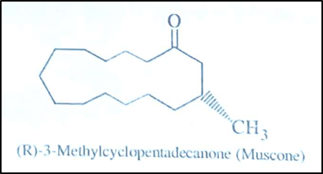
MUSCONE
It is an organic compound present in musk which is obtained from musk deer. It is oily liquid and is primary contributor to odour of musk. It has characteristic smell of being "Musky".
Chemical Composition: Muscone obtained from musk deer is a macromolecule, which has 15-membered ring structure with a keto group and a methyl group on it. The structural formula of compound is as given below:

Slide 8
Natural Source and Synthesis
Natural source of Muscone is musk deer, but it involves killing of this endangered species.
Therefore, all the muscone used in perfume industry is synthetic or man-made. The man made or synthetic muscone is called as "asymmetric synthesis of (-)-muscone. It begins with commercially available (-)+citronellal and forms the 15-membered ring via ring closing metathesis.
USES
Because of its unique odour, it has been an important component of perfume industry. The perfumes with Musky odour are among the most expensive perfumes and used all over the world.
It has shown a beneficial effect on the patients suffering from angina with a therapeutic effect comparable with that observed in nitroglycerine.

Slide 9


